Slide 1
Virtual Reality Concerts
Exploring Unique Features with Unreal Engine

Slide 2
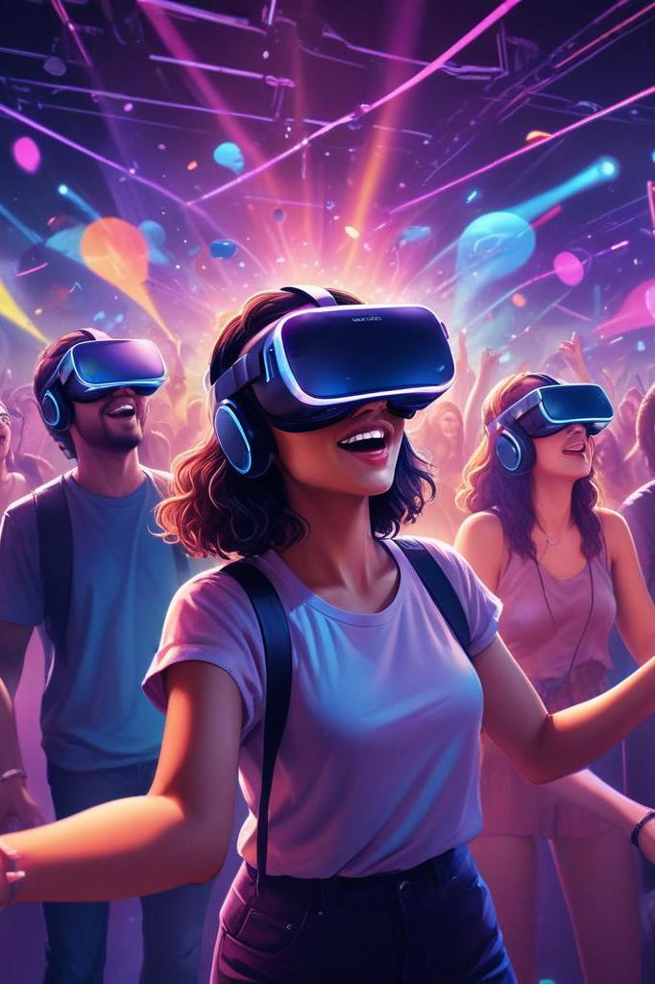
Introduction
This presentation discusses the innovative aspects of virtual reality concerts developed with Unreal Engine, emphasizing the unique features such as proximity chatting and spatial audio.

Slide 3
01
Overview

Slide 4
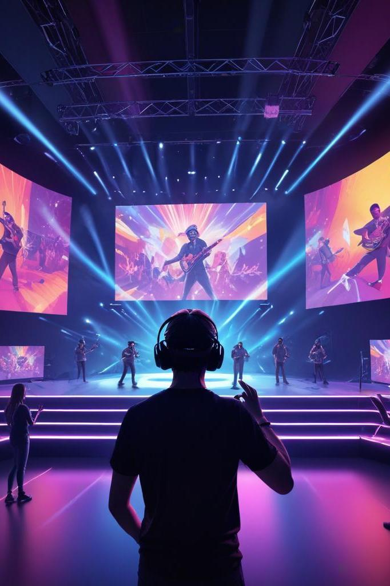
Definition of Virtual Reality Concerts
Virtual reality concerts utilize immersive technology to create a digital environment where users can experience live performances. These events allow fans to engage with artists in real-time, enhancing the concert experience beyond traditional formats.

Slide 5
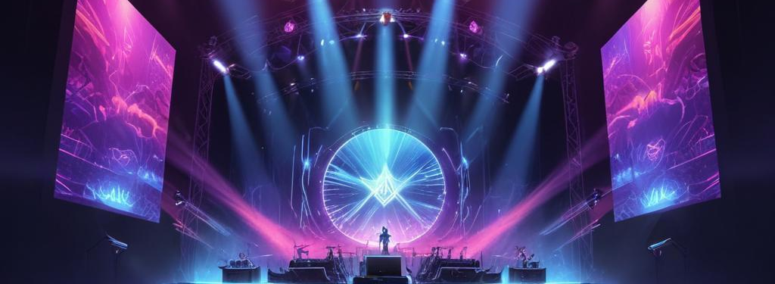
Benefits of Using Unreal Engine
Unreal Engine provides powerful tools for creating stunning graphics and immersive sound experiences. Its versatility allows for customizations, making each virtual concert unique. The engine's ability to handle spatial audio and realistic environments enhances the overall user experience.

Slide 6
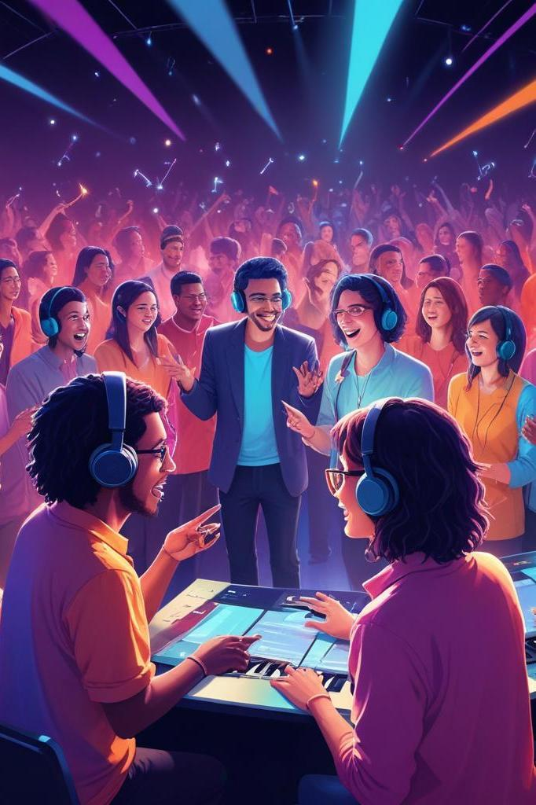
Importance of Unique Features
Unique features such as proximity chatting and spatial audio play a pivotal role in enhancing the virtual reality concert experience. They help create a more interactive and immersive environment that mirrors real-life concerts, promoting social interaction among attendees.

Slide 7
02
Unique Features

Slide 8
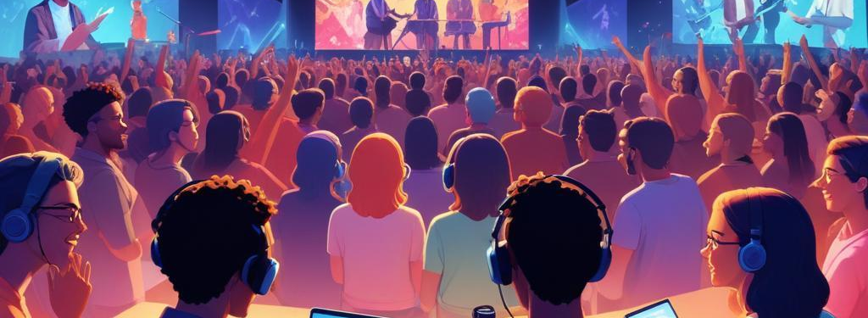
Proximity Chatting Mechanism
Proximity chatting allows users to communicate based on their virtual proximity to one another. This mechanism simulates real-life social interactions, enabling fans to engage with each other and share their concert experience, thus fostering a sense of community.

Slide 9
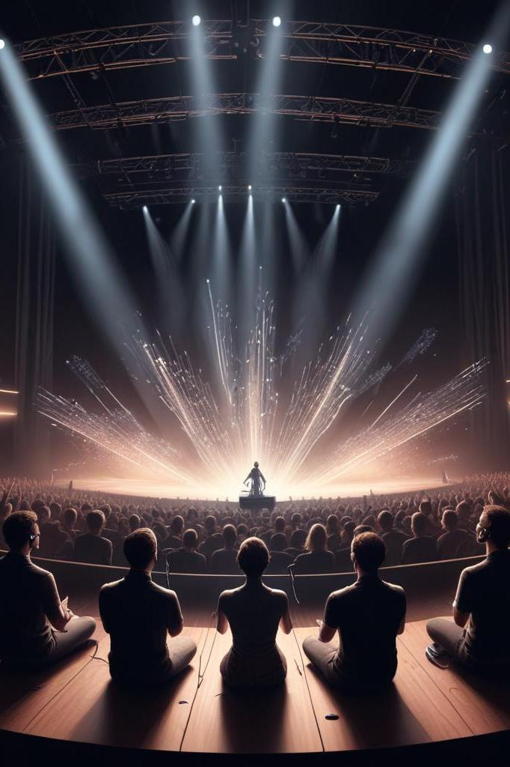
Spatial Audio Implementation
Spatial audio creates an immersive sound environment where sounds come from specific directions, enhancing the realism of the concert experience. This technology allows users to perceive audio the same way they would in a physical space, making performances more engaging and lifelike.

Slide 10
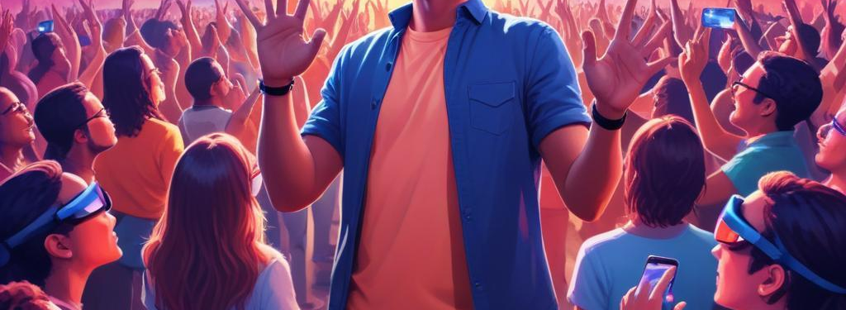
Enhancing User Engagement
By implementing these unique features, virtual reality concerts can significantly enhance user engagement. Participants feel more involved and connected to both the artists and fellow audience members, leading to a more enjoyable and memorable experience.

Slide 11
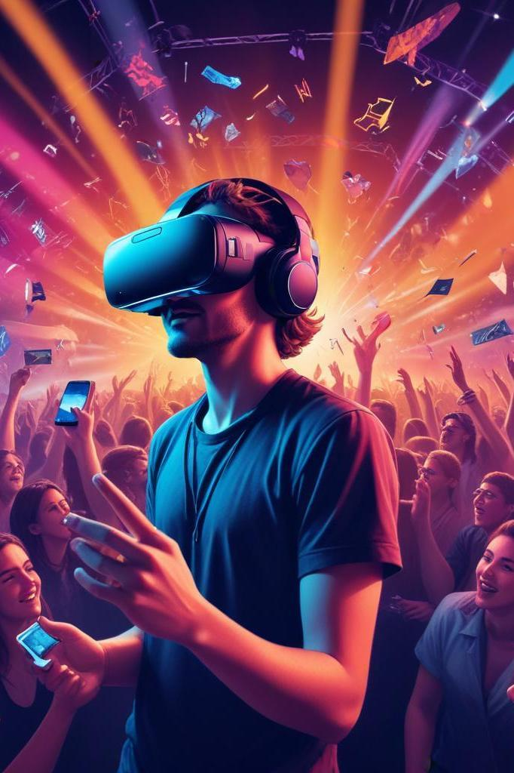
Conclusions
Incorporating unique features like proximity chatting and spatial audio in virtual reality concerts using Unreal Engine not only enriches the overall experience but also encourages greater interaction and engagement among users, making these events stand out in the entertainment landscape.

Slide 12
Thank you!
Do you have any questions?
+91 620 421 838

